Slide 1

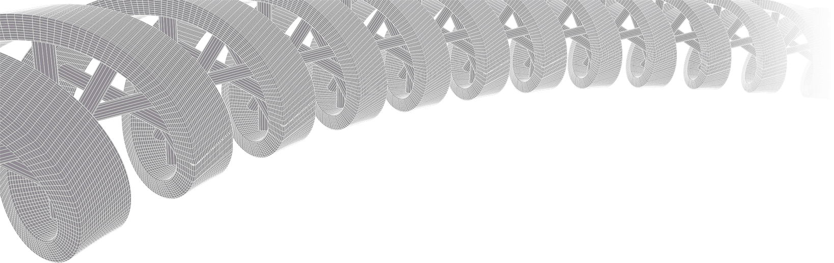

PMBIO Module 08 Immune. Immunogenomics analysis
Malachi Griffith, Obi Griffith, Zachary Skidmore, Huiming Xia
Introduction to bioinformatics for DNA and RNA sequence analysis (IBDR01)
29 October – 2 November, 2018
Glasgow

Slide 2
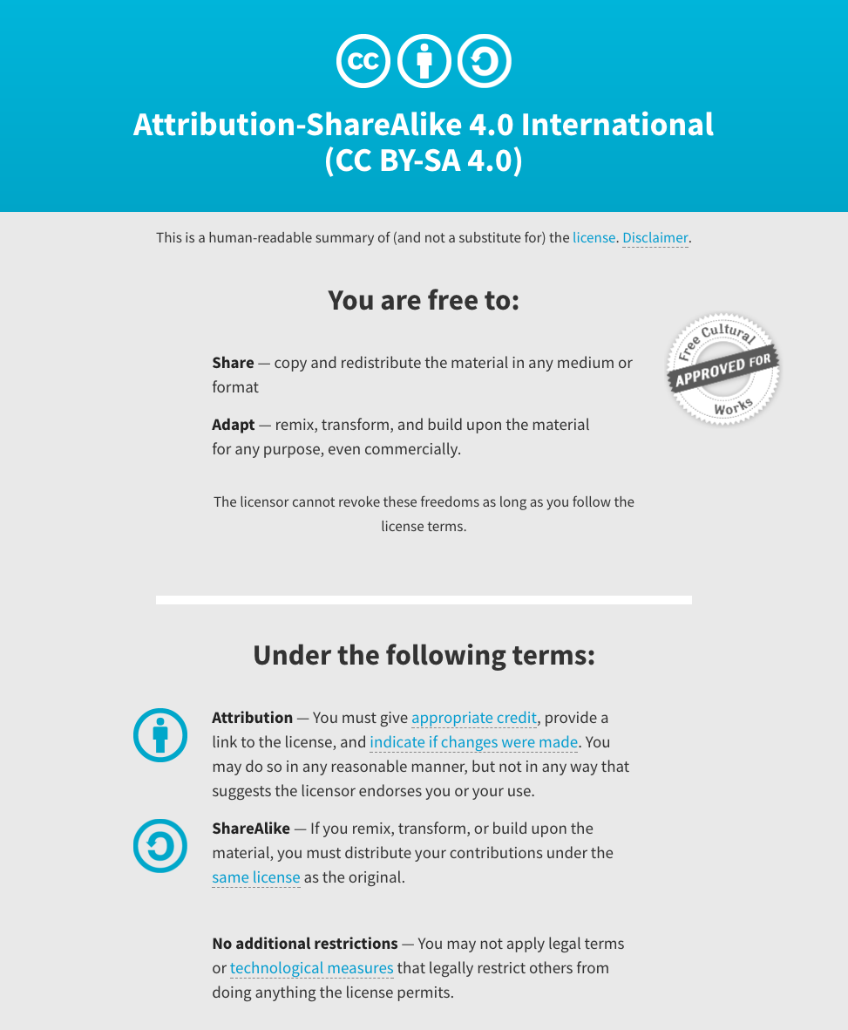
Notes:
Note there are two licenses if effect for this course.
All *content* (lectures, written materials, etc.) are made available under the Creative Commons Attribution-ShareAlike 4.0 International (CC BY-SA 4.0). (https://creativecommons.org/licenses/by-sa/4.0/).
All *code* (R scripts the website code itself) are made available under the MIT License (https://opensource.org/licenses/MIT).

Slide 3
Learning objectives of module 08: Immune
Key concepts: Immunogenomics, adaptive immunity, immunotherapies, personalized cancer vaccines, MHC binding prediction, neoantigen identification and prioritization
Use results from the previous sections (germline variants, somatic variants, gene/transcript expression estimates, variant allele fractions, clonality estimates, etc.) to design a personalized cancer vaccine for our hypothetical patient
Become familiar with the pvactools software for neoantigen identification, prioritization, selection, and DNA vector design

Slide 4
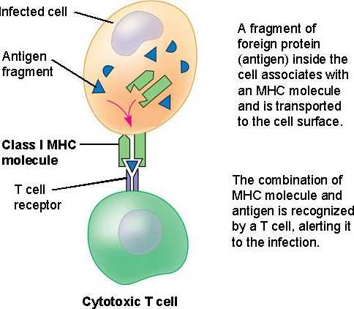
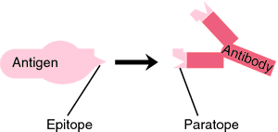
Some basic immune terminology
Antigen: any substance that can initiate an immune response within the body
Epitope: also known as antigenic determinant, is the part of an antigen that is recognized by the immune system. i.e. bound by the receptor on an antibody, B cell, or T cell
MHC Class I molecules: display fragments of proteins from within the cell to cytotoxic T cells
Jasreet Hundal

Slide 5
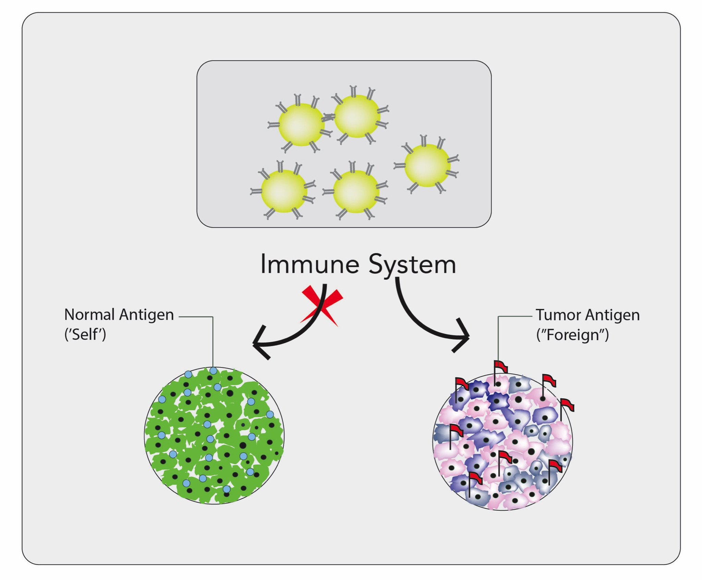
The goal of one class of cancer immunotherapy is to leverage the immune system’s ability to attack non-self or “foreign” cells (recognized by their neoepitopes)
Personalized cancer vaccines and checkpoint inhibition therapies (e.g. Pembrolizumab) are two examples of this type of cancer immunotherapy
Jasreet Hundal

Slide 6
Neoepitopes are relevant to a specific aspect of the immune system
Tumor-specific epitopes (‘Neoepitopes’) are unique to each patient
These unique tumor epitopes result from somatic changes in the tumor genome (i.e. non-synonymous substitutions, insertions, deletions, splice site alterations, fusions, etc.)
Historically, experimental techniques have not been capable of rapidly and systematically identifying neoepitopes …
Jasreet Hundal

Slide 7
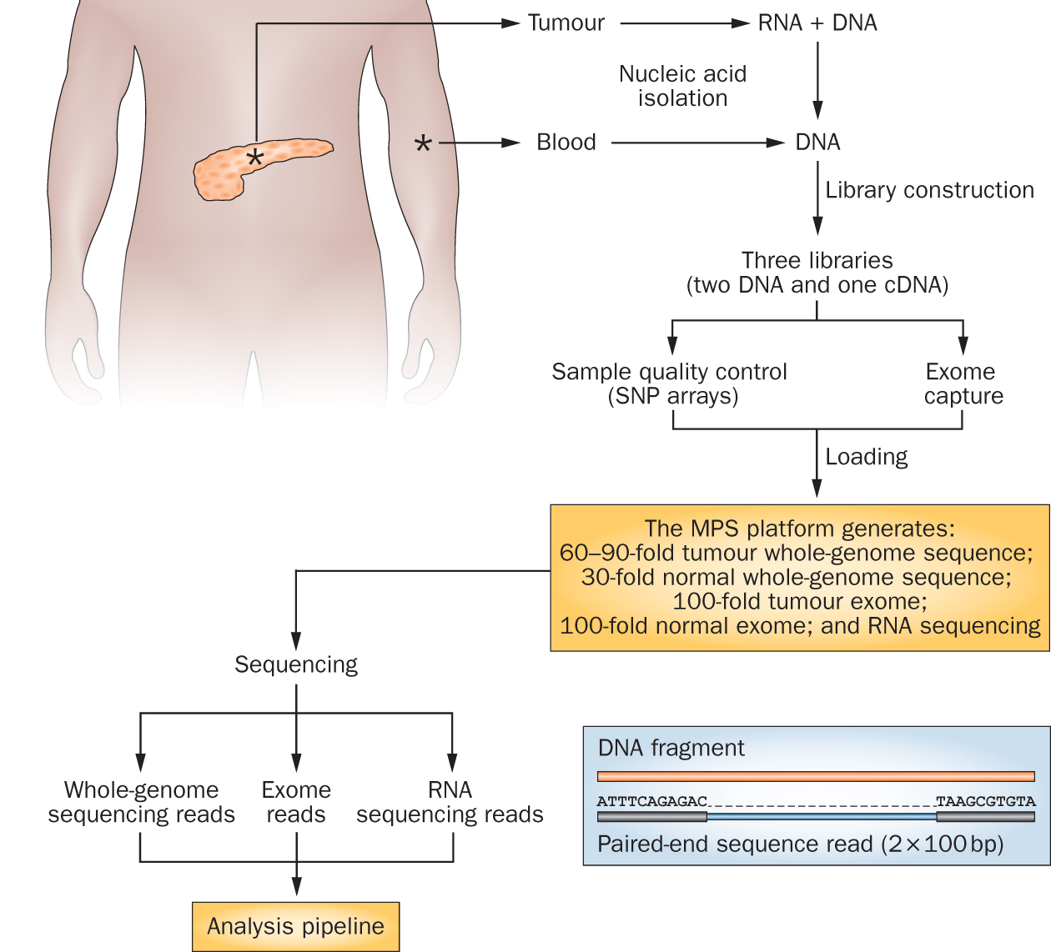
Advances in sequencing technology have changed this

Slide 8
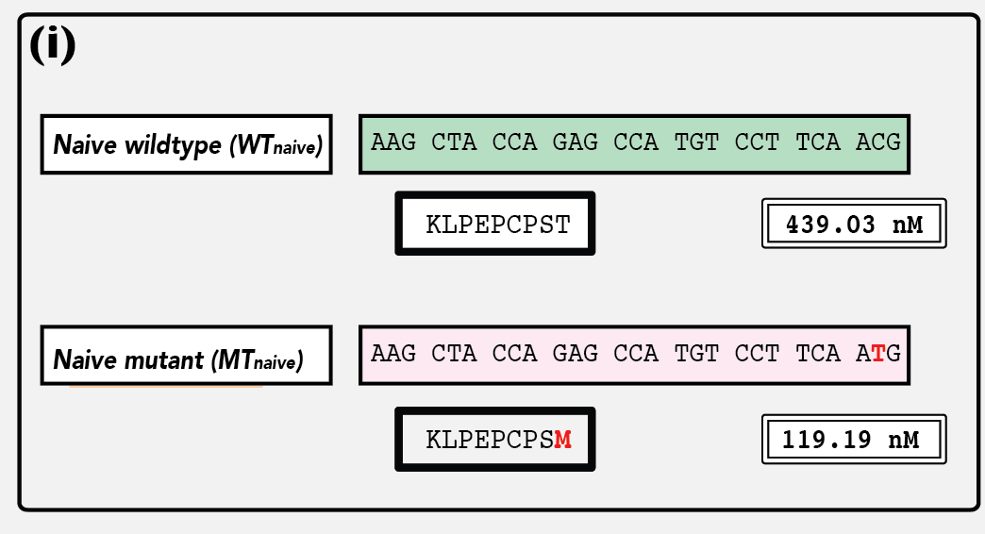
Neoepitopes are peptides resulting from somatic mutations that induce an immune response*
wildtype sequence
mutant sequence
Single base substitution of cytosine (C) to thymine (T), results in a predicted amino acid change of threonine (thr) to methionine (met).
* These are predicted neoepitopes. We rarely know if they are immunogenic…
Jasreet Hundal
Notes:
- Remember that while ATG (AUG) codes for the start codon methionine commonly used as the start of human proteins, methionines also occurs frequently in throughout the body of protein sequences

Slide 9
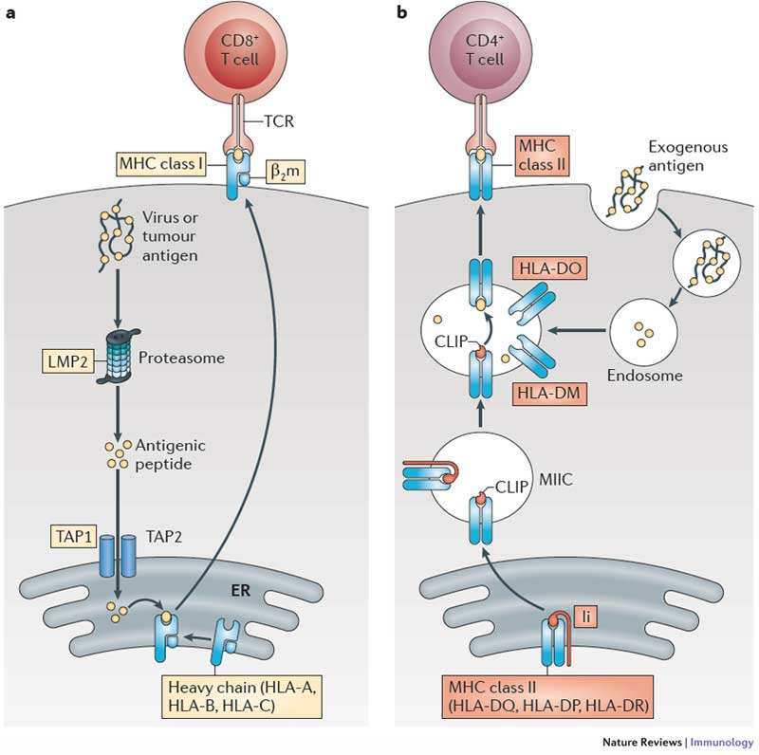
Overview of T cell recognition of neoepitopes (presented by MHC Class I or II proteins)
Two major classes of T cell that recognize epitopes presented by two classes of MHC molecule
Kobayashi and van den Elsen, 2012

Slide 10
Invoking an adaptive immune response against the tumor (focus on CD8+ T cells)
4. T cell receptor that uniquely matches the tumor peptide
1. Tumor produces a unique peptide corresponding to a somatic mutation
3. Neoantigen peptide presented by MHC
2. Processing and presentation of the tumor specific peptide

Slide 11
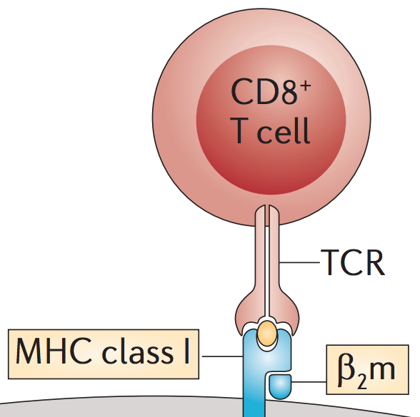
To accurately predict binding of particular peptides to MHC, we need to know which MHC alleles each patient has
3 Mbp stretch of 6p21
The HLA locus is the most heterogeneous region of the genome
>5,000 known variations of the MHC Class I sequences alone
e.g. HLA-A*02:101:01:02N …
Challenge to classical HLA allele typing
Polymorphisms can be outside the sequenced hypervariable region (exons 2-4 of the class I genes)
Challenge to NGS HLA typing
Relies on good sequence coverage and a well annotated database of known HLA sequences
IMGT/HLA Database (www.ebi.ac.uk/imgt/hla/)
Jasreet Hundal
Notes:
The human leukocyte antigen (HLA) system or complex is a gene complex encoding the major histocompatibility complex (MHC) proteins in humans.
The HLA gene complex resides on a 3 Mbp stretch within chromosome 6p21.

Slide 12
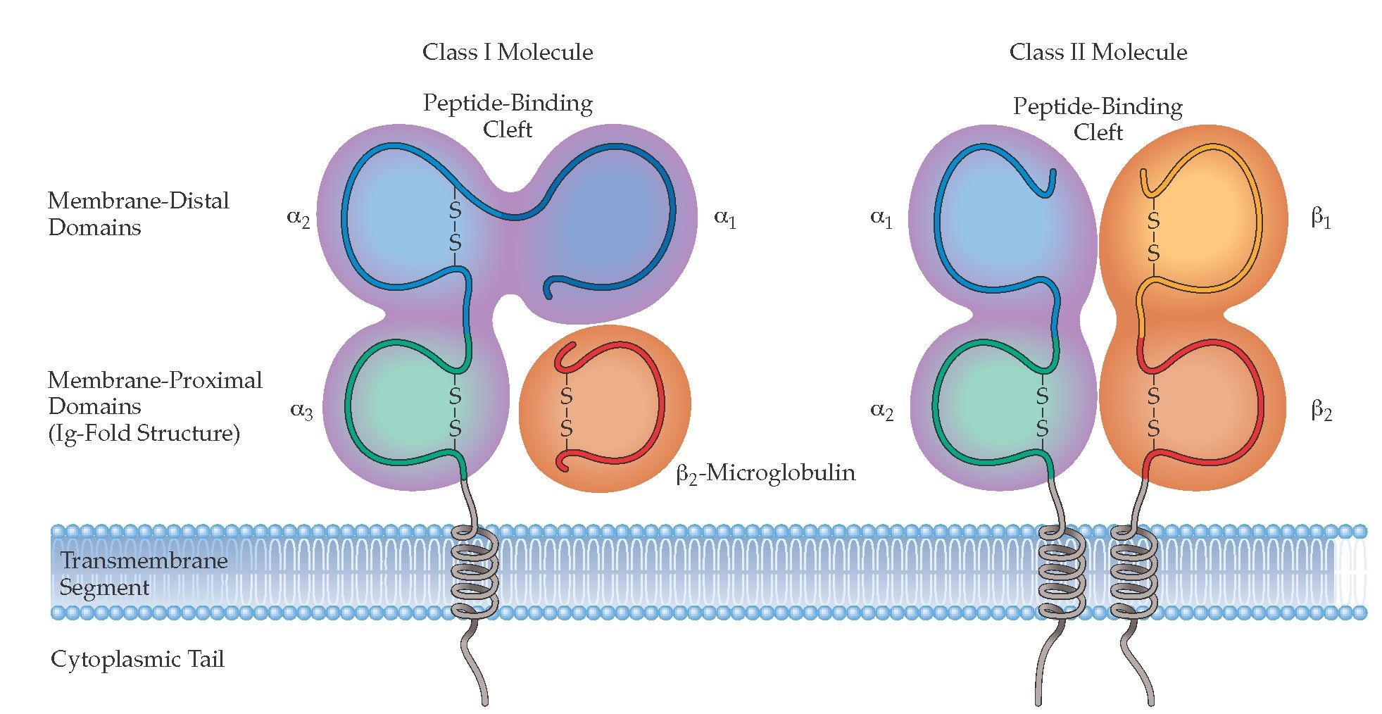
Class I and class II MHC structures
Notes:
Chromosome 6
Polymorphic region of human genome
Involves functions of the immune system (HLA Class I/II)
HLA Class I (A,B,C) - all nucleated cells
HLA Class II (DP, DQ, DR) - antigen presenting cells (dendritic, macrophages, and B-cells)
Codominantly expressed
7,300 HLA-I alleles and 2,200 HLA-II alleles

Slide 13
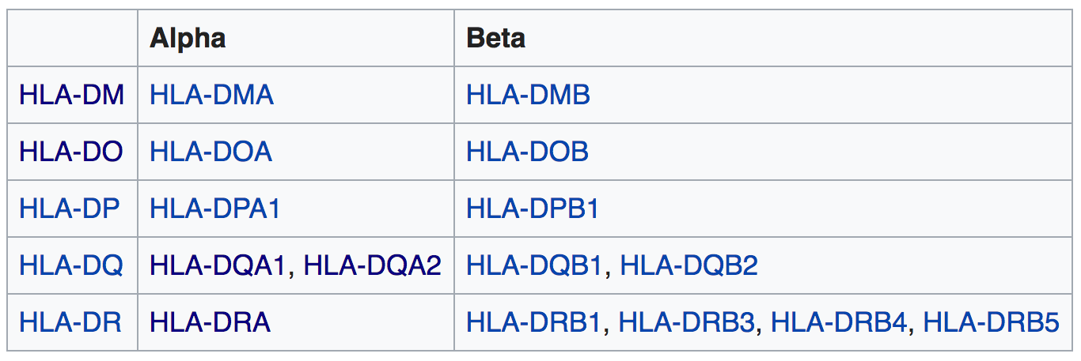
HLA class II pairings

Slide 14
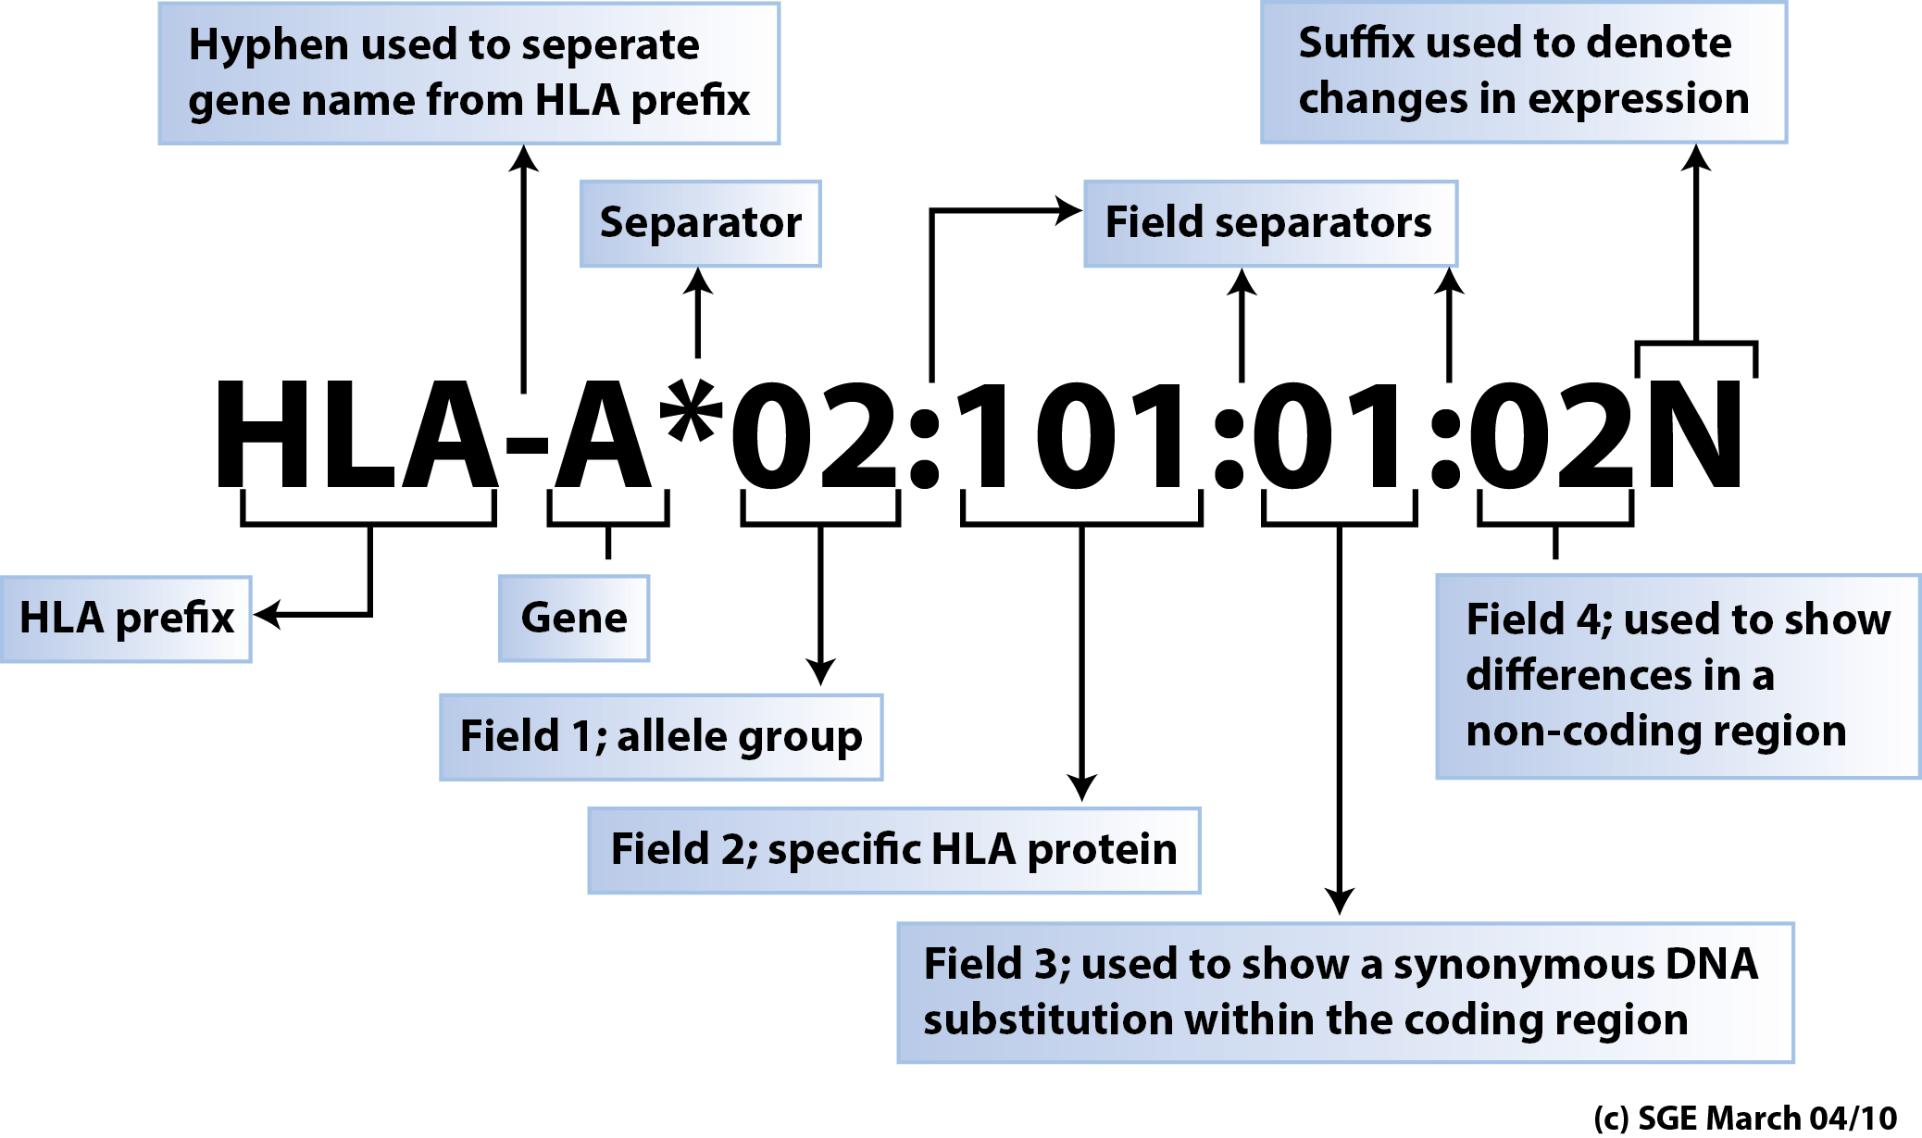
Conventions for HLA allele naming
Adapted from: Nunes et al., 2011

Slide 15
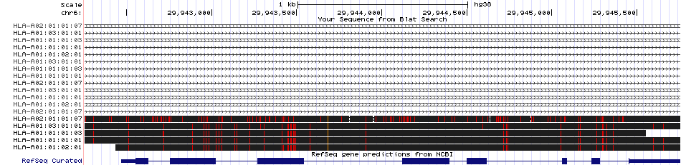
DNA alignment view of some example HLA sequences
Sequence comparison between ~3500 bp genomic sequences of five HLA-A sequences:
HLA-A*01:01:01:01
HLA-A*01:01:01:03 – differences in non-coding regions
HLA-A*01:01:02:01 – synonymous changes in coding regions
HLA-A*01:03:01:01 – some protein coding changes
HLA-A*02:01:01:07 – many protein coding changes (different allele group)

Slide 16
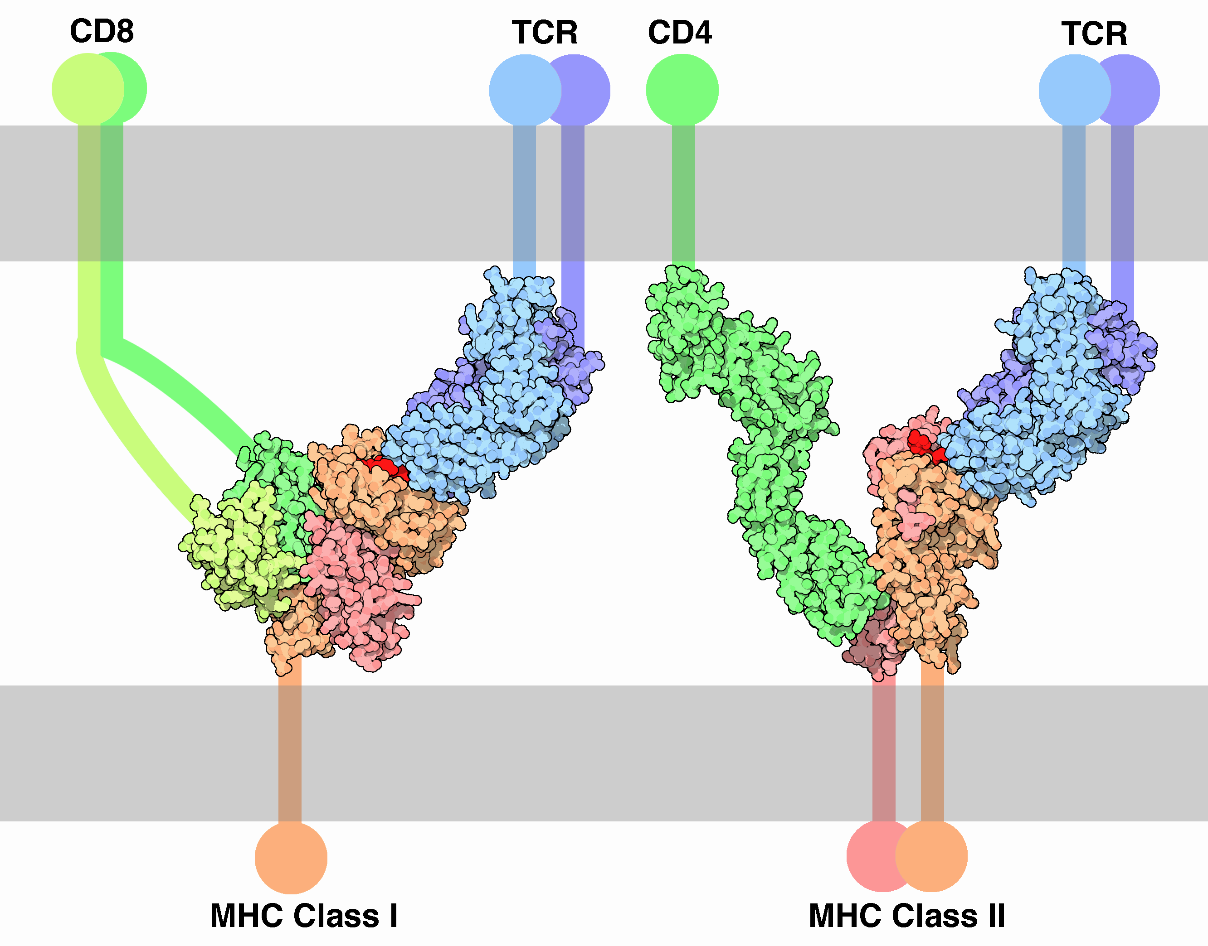
3d view of MHC complex
The three dimensional structure is what really matters
http://pdb101.rcsb.org/motm/63
Notes:
- “An elaborate handshake is performed between a T-cell and an infected cell to make sure that the death sentence is warranted. The primary contact is between the T-cell receptor and the MHC-peptide complex (the peptide is in bright red here). Then, CD molecules bind to other portions of the MHC, strengthening the interaction. Two types of interaction are shown here. MHC class I, which is found on the surface of most of our cells, interacts with T-cell receptors and CD8 on cell-killing T-cells. MHC class II is found primarily on cells that specialize in finding dangerous proteins. It interacts with T-cell receptors and CD4 on other T-cells that stimulate the immune system. All of these proteins are connected to the cell membranes by flexible chains and hinges, so that they can move around and form this complex interaction.” http://pdb101.rcsb.org/motm/63

Slide 17
MHC / HLA resources …
IMGT. The international ImMunoGeneTics information system (http://www.imgt.org)
Genome, transcript, protein, and structure data
Immunoglobulins/antibodies, T cell receptors (TCRs), major histocompatibility complex (MHC) molecules, etc.
The subset of IMGT that deals with sequences of the human MHC (HLA) is hosted separately at EBI:
The IPD-IMGT/HLA Database
Notes:
IMGT, the international ImMunoGeneTics information system (http://www.imgt.org). “IMGT® is a high-quality integrated knowledge resource specialized in the immunoglobulins (IG) or antibodies, T cell receptors (TR), major histocompatibility (MH) of human and other vertebrate species, and in the immunoglobulin superfamily (IgSF), MH superfamily (MhSF) and related proteins of the immune system (RPI) of vertebrates and invertebrates. IMGT® provides a common access to sequence, genome and structure Immunogenetics data, based on the concepts of IMGT-ONTOLOGY and on the IMGT Scientific chart rules. IMGT® works in close collaboration with EBI (Europe), DDBJ (Japan) and NCBI (USA).”
The subset of IMGT that deals with sequences of the human MHC (HLA) are hosted at EBI: https://www.ebi.ac.uk/ipd/imgt/hla/ . This resource is called the IPD-IMGT/HLA database.

Slide 18
Peptide-MHC binding
Major components of neoepitope identification:
Predicting amino acid changes caused by somatic variation in tumor DNA
Predicting whether a short peptide sequence (8-12 amino acids) containing the somatic event will be strongly bound by one of the patient’s MHC molecules
For class I -> two alleles of HLA-A, HLA-B, and HLA-C
Tools: Athlates, HLA-Miner, etc.
Consider all peptide lengths vs. all HLA alleles vs. all registers for the mutation
Tools: pVACtools, OpenVax, etc.
Many more factors …
Notes:
I say relatively small, because while these data sets have 1000s of measurements they represent a tiny slice of the possible search space
There are >5000 known variants of the MHC genes
Even if we consider only nonamers, there are 20^9 = 5.1e+11 possible unique peptide sequences. If we consider peptide lengths of 9-12, this grows to 2.2e+14.

Slide 19
Peptide-MHC binding
There are many existing algorithms that attempt to model the peptide-MHC complex
NetMHC, NetMHCpan, MHCflurry, PickPocket, SMM, SMMPMBEC, NetMHCIIpan, NN-align, SMM-align, etc.
Trained on *relatively* small libraries of peptides with in vitro binding measurements for a relatively small set of MHC alleles
Algorithms try to generalize the sequence/binding relationship to any sequence and MHC allele.
Note. Binding doesn’t mean presentation, and presentation doesn’t mean T cell recognition or cell death.
Notes:
I say relatively small, because while these data sets have 1000s of measurements they represent a tiny slice of the possible search space
There are >5000 known variants of the MHC genes
Even if we consider only nonamers, there are 20^9 = 5.1e+11 possible unique peptide sequences. If we consider peptide lengths of 9-12, this grows to 2.2e+14.

Slide 20
Many algorithms, varied performance
MHC Class I binding algorithms:
Algorithm mean AUC (range)
NetMHC 3.0 (ANN) 0.90 (0.74-0.98)
SMM 0.91 (0.73-0.98)
SMMPMBEC 0.91 (0.74-0.98)
NetMHCpan 0.94 (0.57-1.0)
PickPocket 0.895 (range unavailable)
MHC Class II binding algorithms
Algorithm mean AUC (range)
SMM-align 0.78 (0.66-0.83)
NN-align 0.80 (0.62-0.86)
NetMHCIIpan 0.85 (0.63-0.93)
Chris Miller

Slide 21
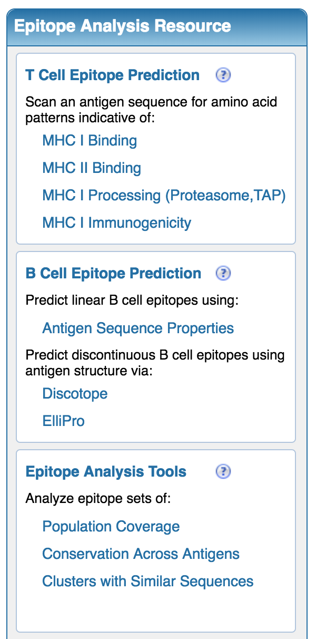
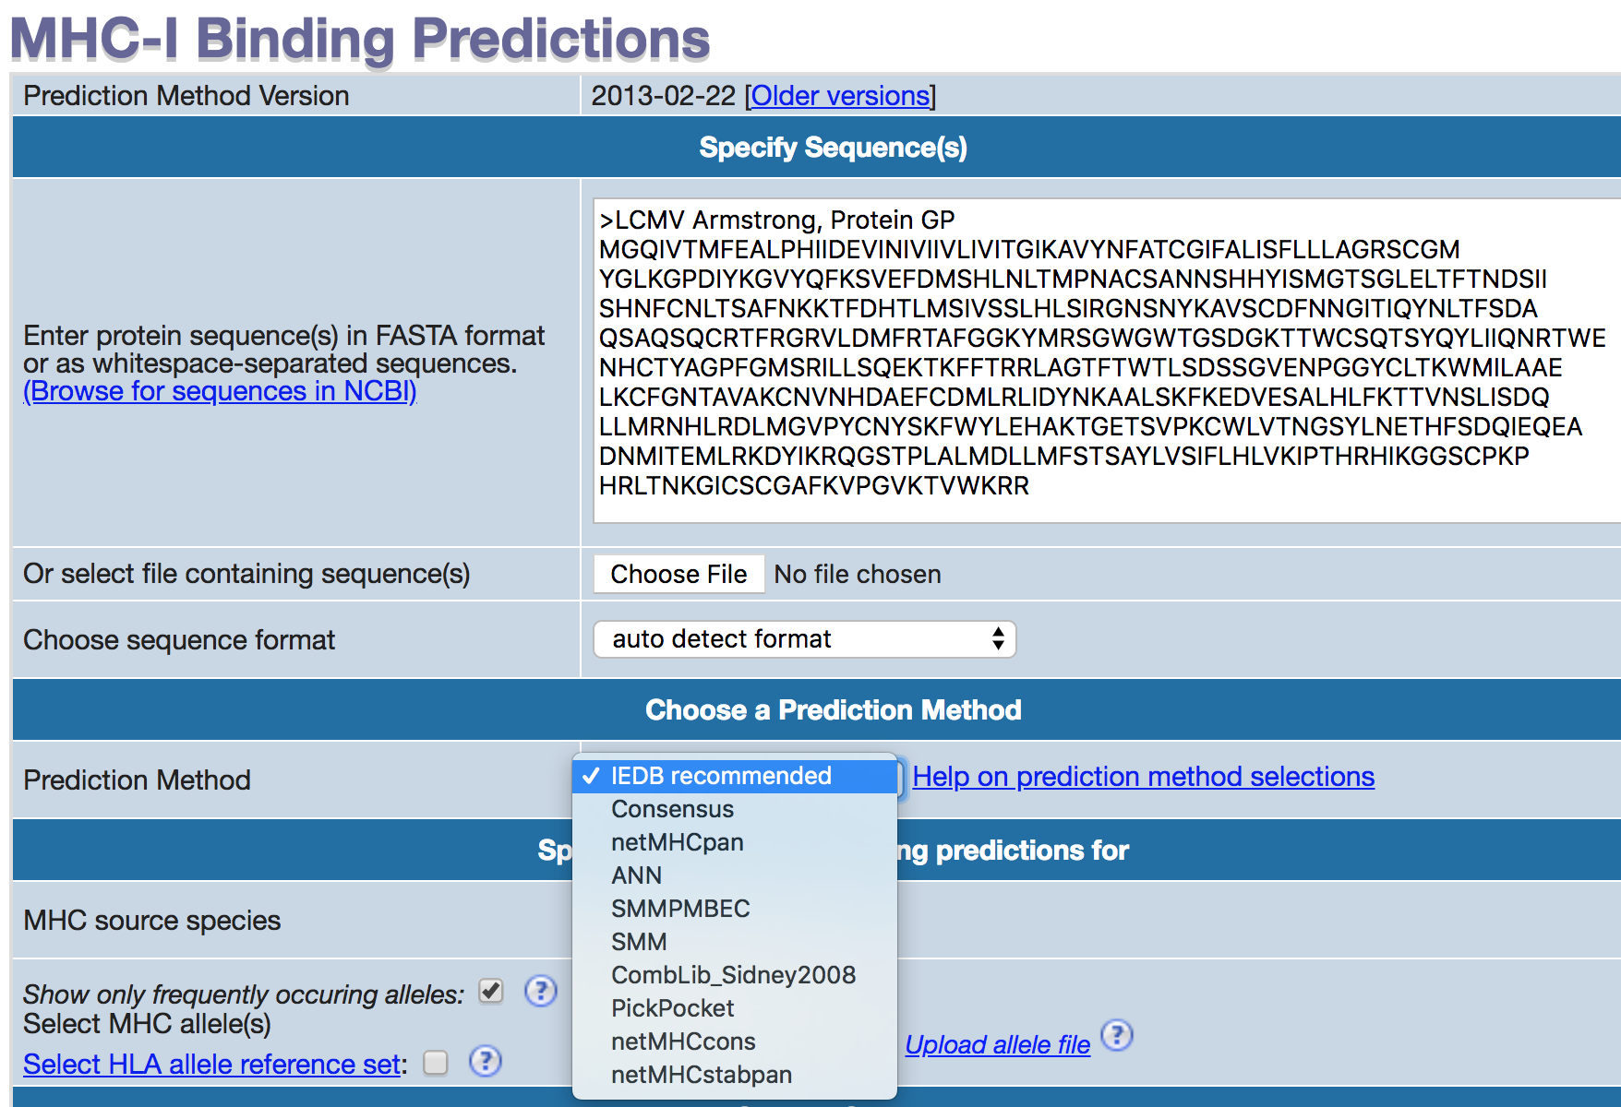
Peptide-MHC binding resources
IEDB analysis resource
Others you will hear about today

Slide 22
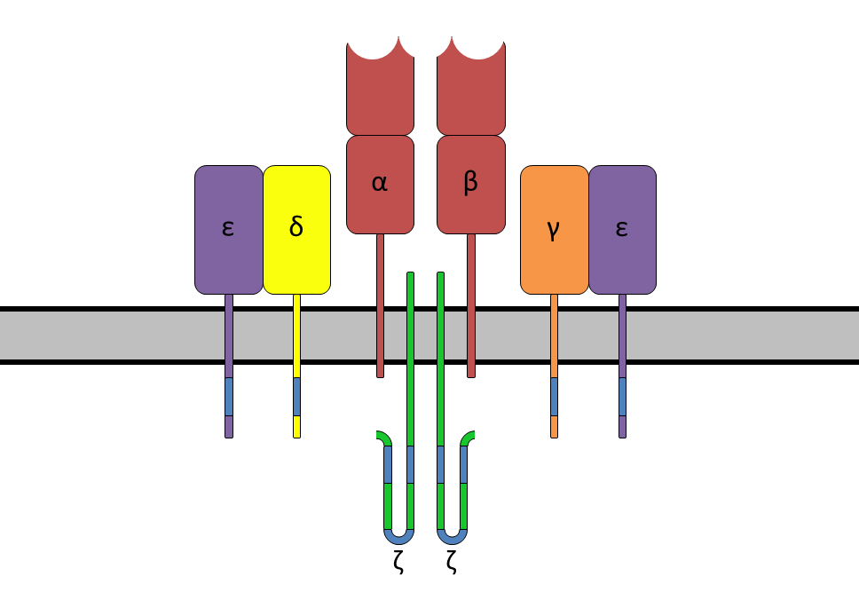
Structure of T cell receptor
TRA undergoes
VJ recombination
TRB undergoes
VDJ recombination
Alpha/Beta form a heterodimer (95% of T cells) or Gamma/Delta (5% of T cells)
Wikipedia CC BY-SA 3.0
Notes:
- https://en.wikipedia.org/wiki/T-cell_receptor
“A diagram showing the alpha-beta T cell receptor complex, including associated CD3 proteins. The blue segments are the ITAMs.”
“The T-cell receptor, or TCR, is a molecule found on the surface of T cells, or T lymphocytes,[1] that is responsible for recognizing fragments of antigen as peptides bound to major histocompatibility complex (MHC) molecules. The binding between TCR and antigen peptides is of relatively low affinity and is degenerate: that is, many TCRs recognize the same antigen peptide and many antigen peptides are recognized by the same TCR. The TCR is composed of two different protein chains (that is, it is a heterodimer). In humans, in 95% of T cells the TCR consists of an alpha (α) chain and a beta (β) chain (encoded by TRA and TRB, respectively), whereas in 5% of T cells the TCR consists of gamma and delta (γ/δ) chains (encoded by TRG and TRD, respectively).”
“The TCR is a disulfide-linked membrane-anchored heterodimeric protein normally consisting of the highly variable alpha (α) and beta (β) chains expressed as part of a complex with the invariant CD3 chain molecules. T cells expressing this receptor are referred to as α:β (or αβ) T cells, though a minority of T cells express an alternate receptor, formed by variable gamma (γ) and delta (δ) chains, referred as γδ T cells. Each chain is composed of two extracellular domains: Variable (V) region and a Constant (C) region, both of Immunoglobulin superfamily (IgSF) domain forming antiparallel β-sheets. The Constant region is proximal to the cell membrane, followed by a transmembrane region and a short cytoplasmic tail, while the Variable region binds to the peptide/MHC complex.”
“The generation of TCR diversity is similar to that for antibodies and B cell antigen receptors. It arises mainly from genetic recombination of the DNA encoded segments in individual somatic T cells by somatic V(D)J recombination using RAG1 and RAG2 recombinases. Unlike immunoglobulins, however, TCR genes do not undergo somatic hypermutation, and T cells do not express Activation-Induced (Cytidine) Deaminase (AID).”
“The TCR alpha chain is generated by VJ recombination, whereas the beta chain is generated by VDJ recombination (both involving a somewhat random joining of gene segments to generate the complete TCR chain).”
“The most common mechanism for activation and regulation of molecules beneath the lipid bilayer is via reversible tyrosine phosphorylation by protein kinase/phosphatase. T cells utilise the Src family kinases in transmembrane signalling largely to phosphorylate tyrosines that are part of immunoreceptor tyrosine-based activation motifs (ITAM) in intracellular parts of CD3 and ζ chains.”

Slide 23
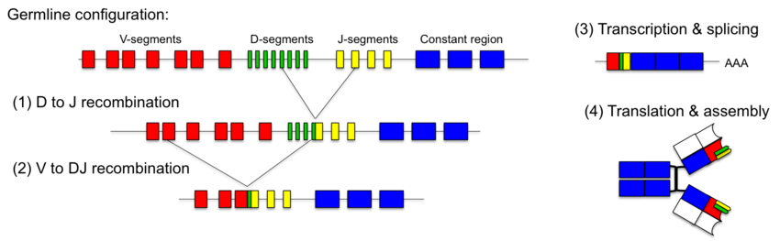
Generation of T cell receptor (TCR) diversity
http://2012.igem.org/wiki/index.php?title=Team:Marburg_SYNMIKRO/Project&oldid=271252
Notes:
- From Entrez Gene: “T cell receptors recognize foreign antigens which have been processed as small peptides and bound to major histocompatibility complex (MHC) molecules at the surface of antigen presenting cells (APC). Each T cell receptor is a dimer consisting of one alpha and one beta chain or one delta and one gamma chain. In a single cell, the T cell receptor loci are rearranged and expressed in the order delta, gamma, beta, and alpha. If both delta and gamma rearrangements produce functional chains, the cell expresses delta and gamma. If not, the cell proceeds to rearrange the beta and alpha loci. This region represents the germline organization of the T cell receptor beta locus. The beta locus includes V (variable), J (joining), diversity (D), and C (constant) segments. During T cell development, the beta chain is synthesized by a recombination event at the DNA level joining a D segment with a J segment; a V segment is then joined to the D-J gene. The C segment is later joined by splicing at the RNA level. Recombination of many different V segments with several J segments provides a wide range of antigen recognition. Additional diversity is attained by junctional diversity, resulting from the random additional of nucleotides by terminal deoxynucleotidyltransferase.”

Slide 24
T cell receptor specificity and repertoire analysis resources
T cell receptor sequences and annotations can be obtained from IMGT/LIGM-DB
e.g. V, D, and J segments of the gene TRB
Sequences are also stored in GenBank
MIXCR
Analysis of T- and B- cell receptor repertoire sequencing data
Alignment of sequence reads to reference TCR sequences to determine T cell clonotypes
VDJdb
A curated database of T-cell receptor sequences with known antigen specificity
Katie Campbell
Notes:
From MIXCR paper: “MiXCR employs a built-in library of reference germline V, D, J and C gene sequences for human and mouse based on corresponding loci from GenBank”

Slide 25
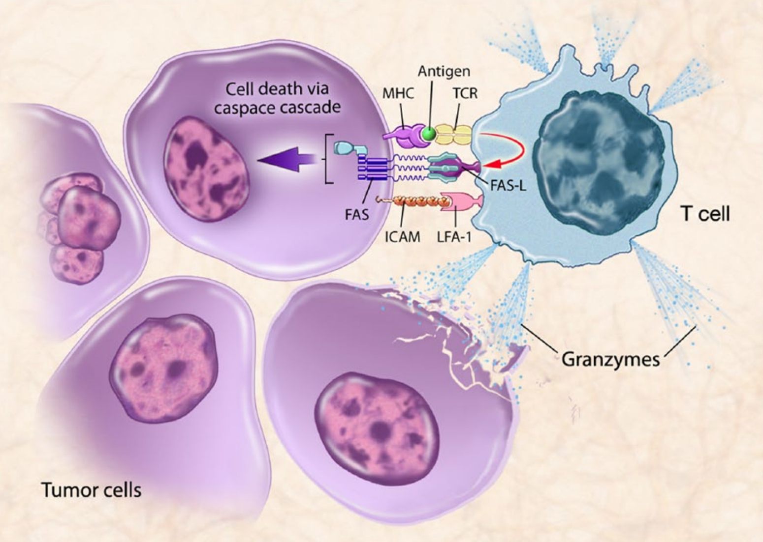
T cell mediated cell death
Singh and Gulley, 2014

Slide 26
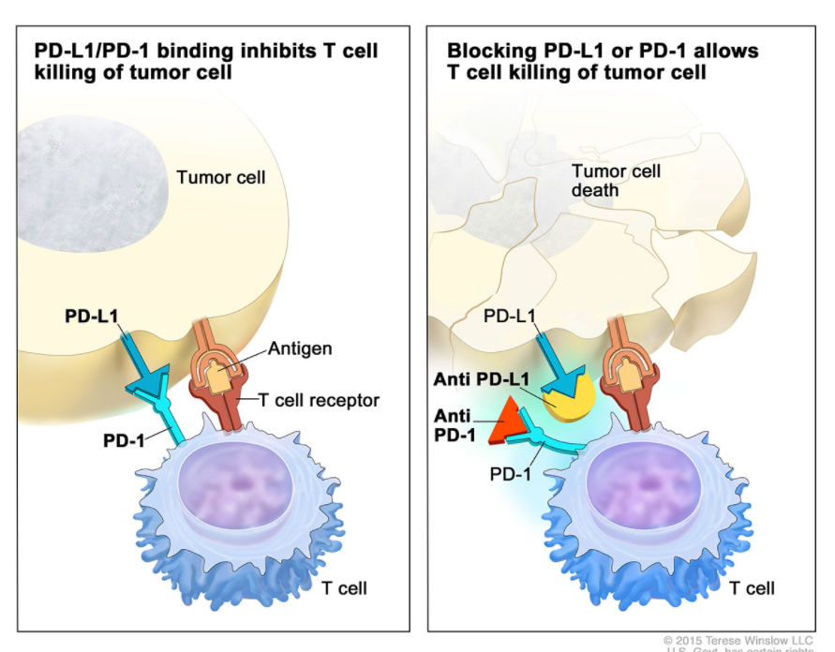
Many tumors express checkpoint molecules to suppress this immune cell death signaling
Checkpoint blockade/inhibitors such as pembrolizumab intercept these immunosuppresive signals and allow T cell mediated death to resume
www.cancer.gov
Notes:
- PD-1 is the receptor, PD-L1 is the ligand

Slide 27
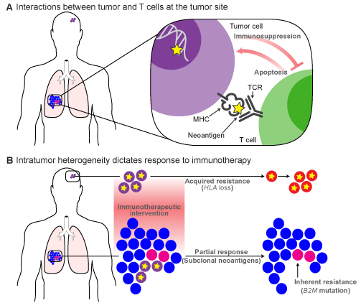
There are many other diverse mechanisms of resistance to immune response
Loss of the tumor variant
deletion of that genomic region
outgrowth of a sub-clonal population that does not contain the neoepitope variant
Interfere with correct processing of the neoepitope
Reduced expression or loss of the MHC molecule that presents the neoepitope
Or important co-factors such as B2M
Interference with signaling cascade that leads to apoptosis
As with all cancer treatment modalities, mechanisms of resistance will be diverse
Inherent/acquired, intrinsic/extrinsic, ephemeral/sustained, direct/indirect …
Katie Campbell and Kilannin Krysiak

Slide 28
Identifying and characterizing neoepitopes is one critical element of this area of research
For understanding response to checkpoint inhibitors and for designing personalized cancer vaccines that direct an immune attack

Slide 29
An example neoepitope characterization workflow
HLA typing
Jasreet Hundal & Katie Campbell
Shirley X. Liu, Elaine R. Mardis. Applications of Immunogenomics to Cancer. Cell Press. 2017.

Slide 30
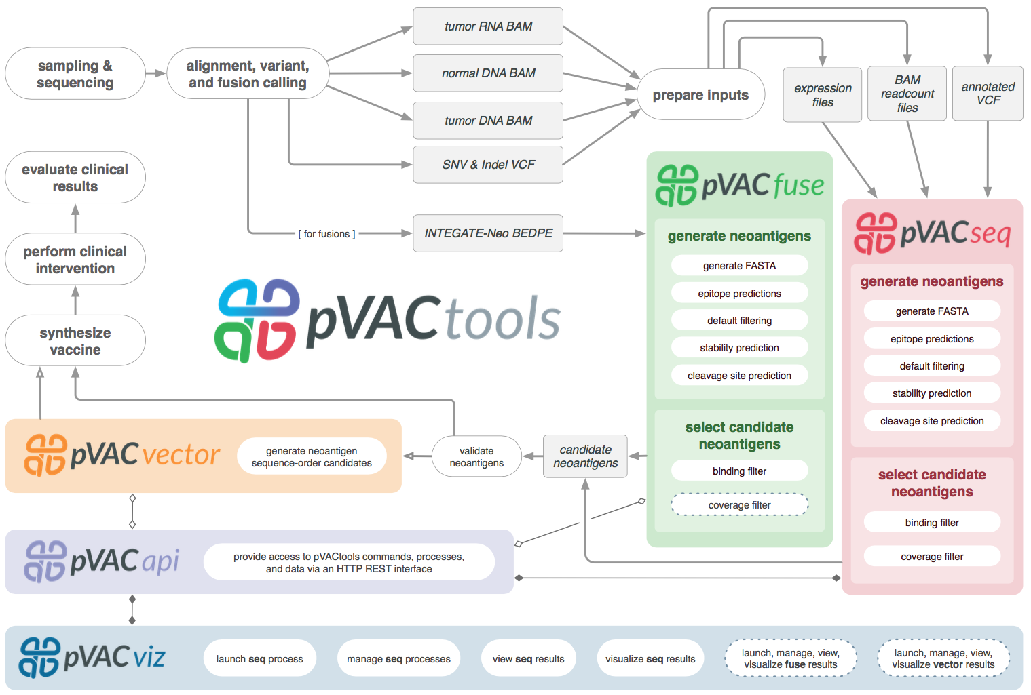
pVACtools (pvactools.org) is one of several neoepitope identification/prioritization pipelines
Notes:
pVACseq - Neoantigen prediction for SNVs and Indels
pVACfuse - Neoantigen prediction for fusions
pVACvector - Optimizing design of spacers and shortlisted neoantigens to prevent high-affinity junctional epitopes (DNA Vector vaccines)
pVACviz - Browser-based UI for launching, managing, reviewing, and visualizing the results of pVACtools processes
pVACapi - HTTP REST interface to the pVACtools suite

Slide 31
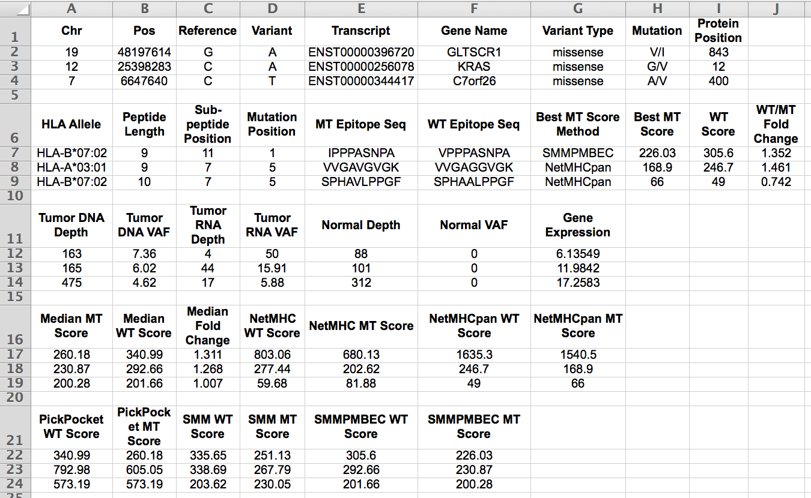
Example result from pVACtools

Slide 32
Results that validate the immunogenicity of predicted neoepitopes in patients are still lacking

Slide 33
Summary of useful resources (questions?)
Databases
IPD-IMGT/HLA Database (EBI)
Immune Epitope Database, IEDB (La Jolla IAI)
IMGT database (LIGM, Montpellier, France)
Tools
IEDB tools – binding predictors
pVACtools – vaccine design
OpenVax – vaccine design
MIXCR – TCR repertoire analysis

